Slide 1
ANGULAR 7 FEATURES
Tumpala. Chitra Divya Kumari
ID:5067554

Slide 2
OBJECTIVE:
Features of Angular 7
Animation
Material
Guards

Slide 3
What is Angular 7?
Angular is a framework to build a web application, which is becoming popular because of its unique features and ease to build an application. Angular 7 is an open source framework developed by Google. It completely relies on HTML and JavaScript. It converts a static HTML page into dynamic HTML page.

Slide 4
Prerequisites of Angular7.
Angular2
TypeScript
HTML
CSS

Slide 5
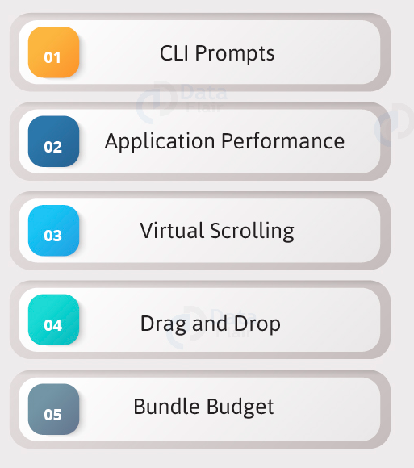
Features of Angular7…

Slide 6
1. CLI Prompts
It helps users to make a decision. It asks users about “want to add routing? Y/N” and about the type of styles user want to use.

Slide 7
Commads used in Angular7 projects…
Sr.No | Commands and Description
1 | Component ng g component new-component
2 | Directive ng g directive new-directive
3 | Pipe ng g pipe new-pipe
4 | Service ng g service new-service
5 | Module ng g module my-module
6 | Test ng test
7 | Build ng build --configuration=production // for production environment ng build --configuration=staging // for stating environment

Slide 8
2. Application Performance
Earlier reflect-metadata is used in production but it is required at the time of development. Therefore, ployfill.ts is removed by default in angular 7.

Slide 9
3. Virtual Scrolling
Google accelerates the speed of Angular 7 for a huge scrollable list.
Start with a plain Angular table
We’re starting with a pretty simple example of a table using a *ngFor loop

Slide 10
1 2 3 4 5 6 7 8 9 10 11 12 13 14 15 | <table> <thead> <tr> <td>Name</td> <td>ID</td> </tr> </thead> <tbody> <tr *ngFor="let row of tableData"> <td>{{row.name}}</td> <td>{{row.id}}</td> </tr> </tbody> </table>

Slide 11
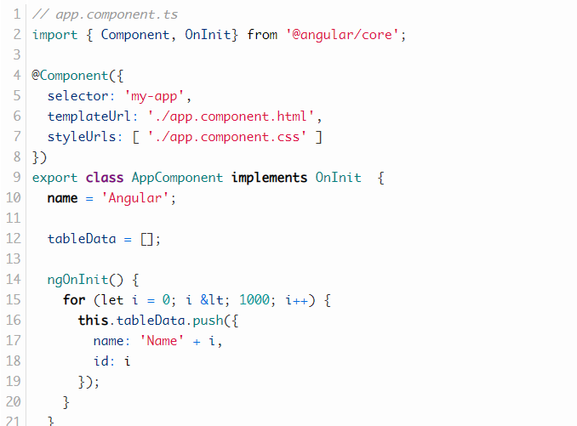
The tableData property is defined in the corresponding component.ts file.

Slide 12

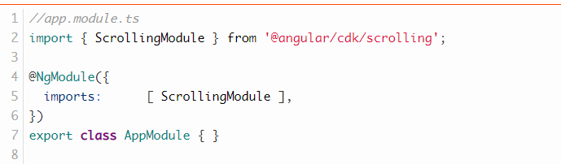
Introducing virtual scrolling
The Angular CDK provides a scrolling component. We’re now going to add it to our plain table in 4 simple steps.
1. Add the dependency
2. Add ScrollingModule

Slide 13
3. Add Scrolling Component
Step 2 is to add the <cdk-virtual-scroll-viewport> element around the markup of your table. We need to provide the attribute [itemSize]=”heightOfRowInPx” that tells the scrolling component how high each row is.
4. replace *ngFor with *cdkVirtualFor
instead of using *ngFor we’re going to use *cdkVirtualFor that is needed in order for the virtual scrolling to work as intended.

Slide 14
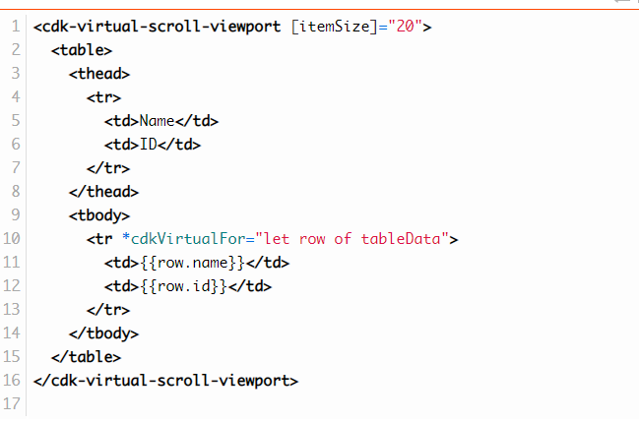

Slide 15
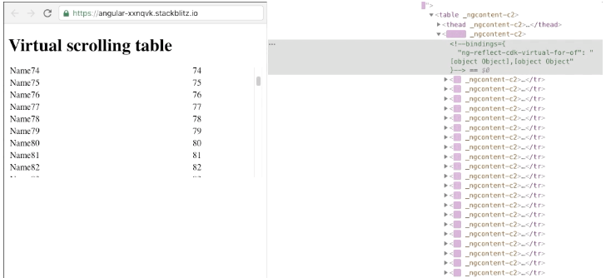
Result..
If we inspect the DOM changes after introducing the <cdk-virtual-scroll-viewport> we see that the browser is removing and adding DOM Nodes as we are scrolling.

Slide 16
4. Drag and Drop
It comes with the feature of automatic rendering.
5.Bundle Budget
If the bundle size is more than 2MB, a warning message provided and for above 5MB, an error will be given.

Slide 17
Animation
Animations add a lot of interaction between the html elements. Animation was available with Angular 2, from Angular 4 onwards animation is no more a part of the @angular/core library, but is a separate package that needs to be imported in app.module.ts.

Slide 18
To start with, we need to import the library with the below line of code

Slide 19
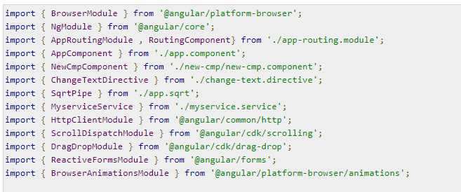
The BrowserAnimationsModule needs to be added to the import array in app.module.ts as shown below −

Slide 20
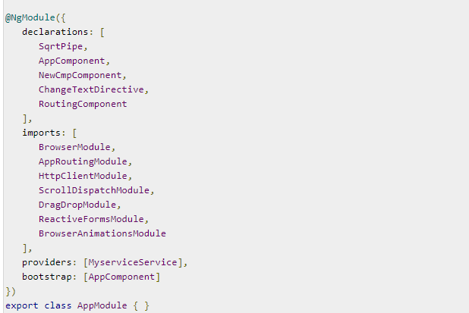

Slide 21
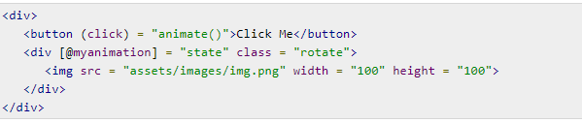
In app.component.html, we have added the html elements, which are to be animated.
Let us now see the app.component.ts where the animation is defined.

Slide 22
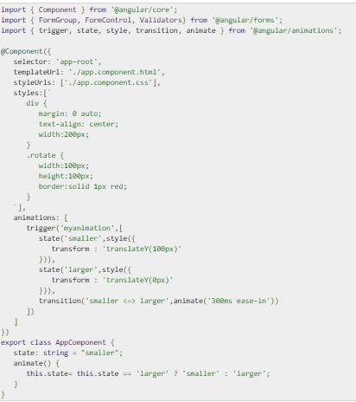

Slide 23
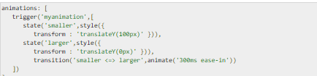
We have to import the animation function that is to be used in the .ts file as shown above.
Here we have imported trigger, state, style, transition, and animate from @angular/animations.
Now, we will add the animations property to the @Component () decorator −

Slide 24

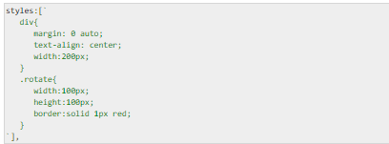
Let us now see the .html file to see how the transition function works −
There is a style property added in the @component directive, which centrally aligns the div. Let us consider the following example to understand the same −

Slide 25

Here, a special character [``] is used to add styles to the html element, if any. For the div, we have given the animation name defined in the app.component.ts file.
On the click of a button it calls the animate function, which is defined in the app.component.ts file as follows −

Slide 26
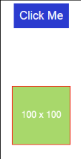
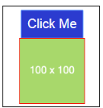
This is how the output in the browser (http://localhost:4200/) will look like −

Slide 27

Materials
Materials offer a lot of built-in modules for your project. Features such as autocomplete, datepicker, slider, menus, grids, and toolbar are available for use with materials in Angular 7.
To use materials, we need to import the package. Angular 2 also has all the above features but they are available as part of the @angular/core module. From Angular 4, Materials module has been made available with a separate module @angular/materials. This helps the user to import only the required materials in their project.
Following is the command to add materials to your project −

Slide 28
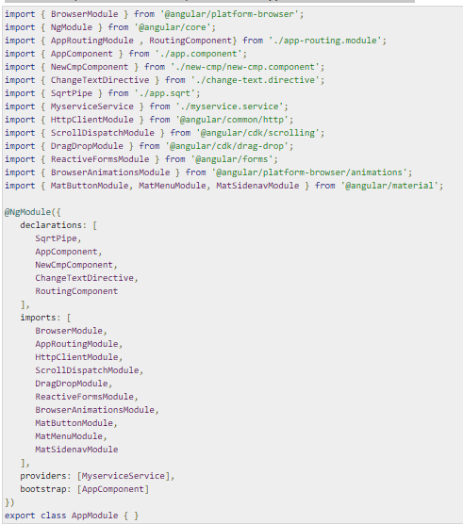
We will now import the modules in the parent module - app.module.ts as shown below.

Slide 29
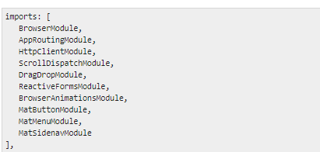
In the above file, we have imported the following modules from @angular/materials.
And the same is used in the imports array as shown below −

Slide 30
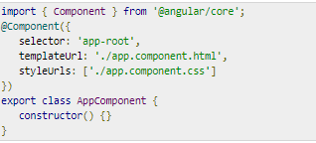
The app.component.ts is as shown below −
Let us now add the material-css support in styles.css.

Slide 31
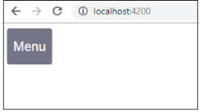
To add menu, <mat-menu></mat-menu> is used. The file and Save As items are added to the button under mat-menu. There is a main button added Menu. The reference of the same is given the <mat-menu> by using [matMenuTriggerFor]="menu" and using the menu with # in<mat-menu>.
The below image is displayed in the browser −

Slide 32
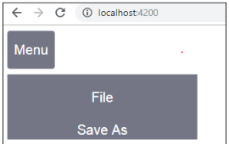

Slide 33
Angular Router: Using Route Guards
The Angular router’s navigation guards allow to grant or remove access to certain parts of the navigation. Another route guard, the CanDeactivate guard, even allows you to prevent a user from accidentally leaving a component with unsaved changes.

Slide 34
Here are the 4 types of routing guards available:
CanActivate:
Controls if a route can be activated.
CanActivateChild:
Controls if children of a route can be activated.
CanLoad:
Controls if a route can even be loaded. This becomes useful for feature modules that are lazy loaded. They won’t even load if the guard returns false.

Slide 35
CanDeactivate:
Controls if the user can leave a route. Note that this guard doesn’t prevent the user from closing the browser tab or navigating to a different address. It only prevents actions from within the application itself.

Slide 36
Simple CanActivate Route Guard
Route guards are most often implemented as classes that implement the needed route guard interface. Let’s see an example with a CanActivate route guard where we ask an auth service if the user is authenticated:

Slide 37
can-activate-route.guard.ts
import { Injectable } from '@angular/core'; import { CanActivate, ActivatedRouteSnapshot, RouterStateSnapshot } from '@angular/router'; import { AuthService } from './auth.service';

Slide 38
@Injectable() export class CanActivateRouteGuard implements CanActivate { constructor(private auth: AuthService) {} canActivate(route: ActivatedRouteSnapshot, state: RouterStateSnapshot): boolean { return this.auth.isUserAuthenticated(); } }

Slide 39
app.module.ts
import { AppRoutingModule } from './app-routing.module'; import { CanActivateRouteGuard } from './can-activate-route.guard'; import { AuthService } from './auth.service';

Slide 40
@NgModule({ declarations: [ // ... ], imports: [ AppRoutingModule, // ... ], providers: [ AuthService, CanActivateRouteGuard ], bootstrap: [AppComponent] }) export class AppModule { }

